Slide 1
Built Environment
October 20, 2022
Jeremy Morrison MPH, Obesity Prevention Consultant
Magen Schoonover MS, Wellness Consultant
1
Notes:
Intro- Magen/Jae

Slide 2
Agenda
Understanding Walkability
Current State of Built Environment
Built Environment & Mental Health
Access
Implementation
Notes:
Jae:
Understanding Walkability:
What is it & Why is it important?
Current State of Built Environment:
Nationally vs. Statewide
Intersection of built environment and mental health:
Access
Implementation:

Slide 3
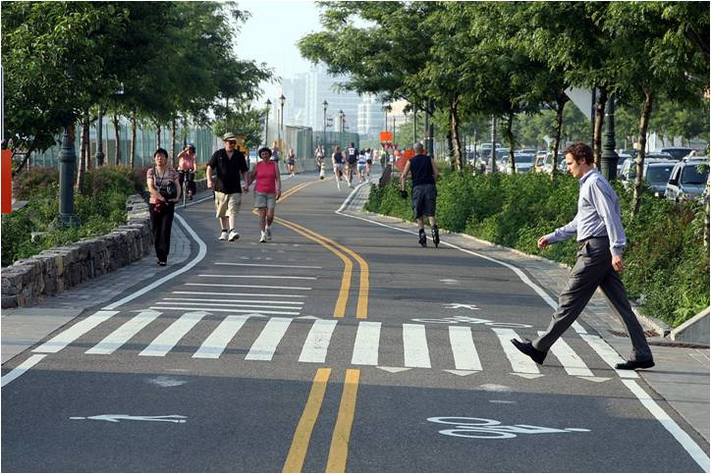
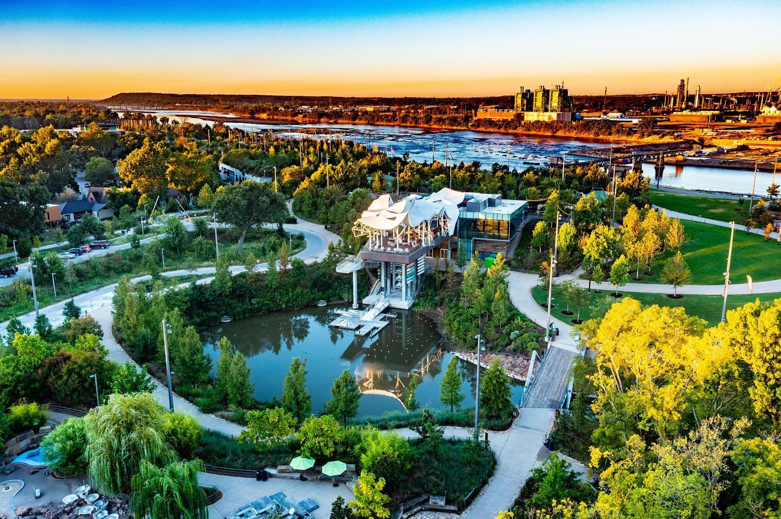
Understanding walkability
A concept relating to an environment’s level of supporting a range of pedestrian mobility through quality infrastructure, connectivity, and public space.
Quality Infrastructure
Connectivity
Public Space
3
Notes:
Jae:
We will start with Walkability. Walkability can be most easily defined as: the influence of the built environment on physical activity
3 components of a walkability we will be discussing today are:
Quality of the infrastructure
Connectivity – does it take you where you want to go
Public Space Design
If these 3 components are brought together, you end up with safe, equitable, and accessible movement through the city or community, and incentive for pedestrian movement.

Slide 4
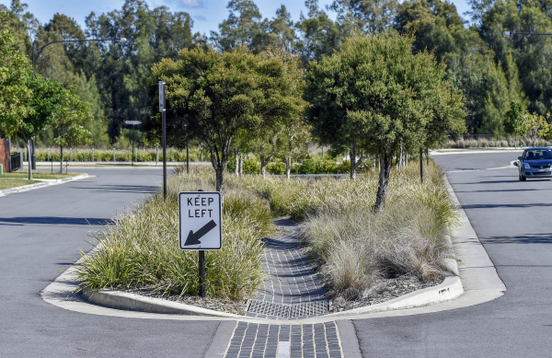
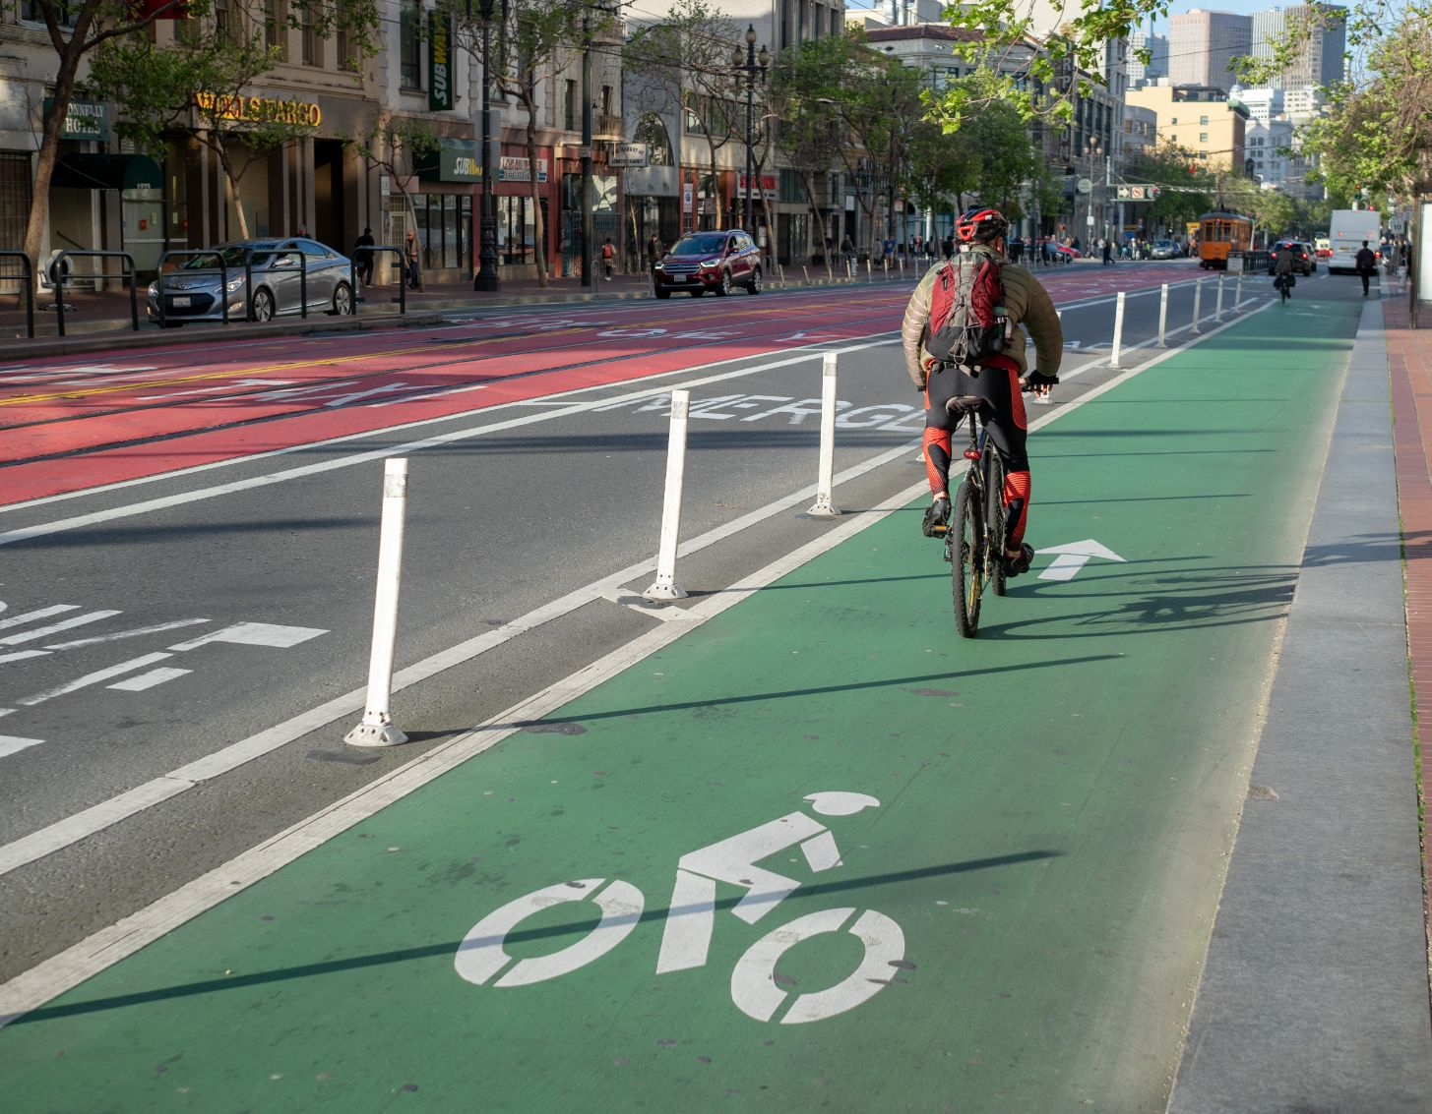
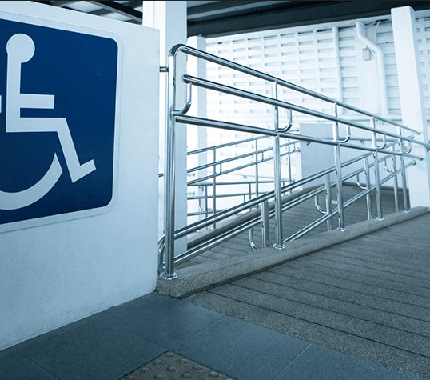
Understanding walkability - Quality
Aspects of Quality Walkable Infrastructure that Support Mental Health
Climate Resilient
Activity Friendly / Health Promoting
Accessible
4
Notes:
Jae:
The first aspect of Quality infrastructure, specifically infrastructure that can support mental health is climate resiliance. We’re lucky enough to live in Oklahoma where the weather is tolerable for most of the year. However that doesn’t inoculate us against having to plan for inclement weather. Ensuring that infrastructure is resilient to the mother nature is a key aspect of ensuring that your walkable environment will remain walkable, rain or shine.
Second, Ensuring infrastructure is activity friendly and health promoting, Looking at that picture, you can get a clear sense that the bike lane is safe, convenient, and easy to use. All of those elements create a larger environment where physical activity is not only possible but enjoyable.
Lastly, all quality infrastructure must be accessible for people of all ages and abilities. Ensuring that new walkable areas are ADA compliant is critical. Also ensuring ADA compliance, without compromising the aesthetics the a space is key. For example, brick pedestrian paths may look amazing but they compromise mobility for individuals who have mobility restrictions.

Slide 5
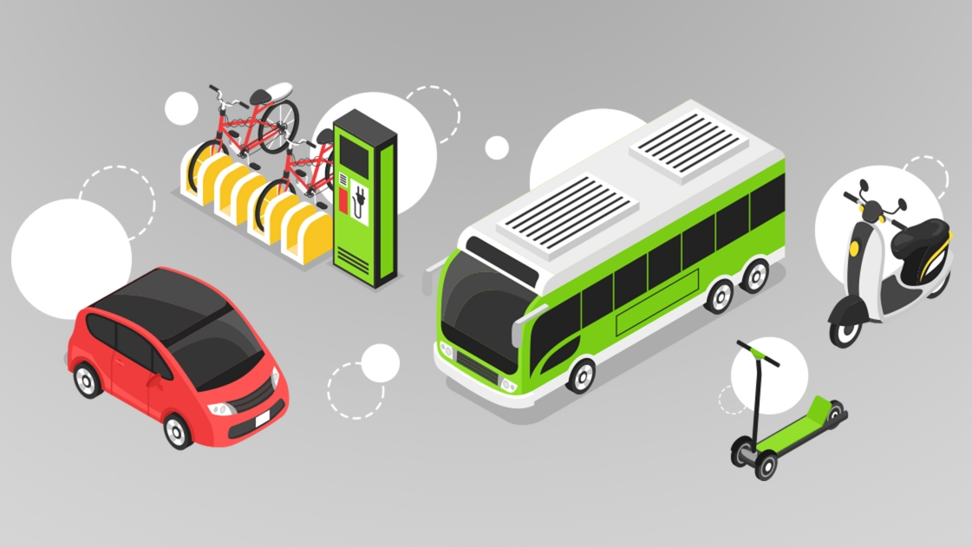
Understanding walkability - Connectivity
Communities and cities with high connectivity allow multimodal transportation to and from points of interest across the city. More importantly, that transportation is interwoven through safe, walkable corridors.
5
Notes:
Jae:
Lastly we want to consider connectivity. Having walkable communities that are easily navigated on foot, accessible through different modes of transportation, and provide clear connections to where you want to go are key to increasing physical activity throughout urban and rural areas. Having a walkable community that does not lead pedestrians to points of interests or incentivize them through beautification of the area are seldom used. Identifying “walkable hotspots” is key. A walkable hotspot is a corridor that connect specific types of commerce to commerce, residential to commerce, or points of interest. Identifying the walkable hotspots and ensuring that these corridors connect to other means of transportation is critical.

Slide 6
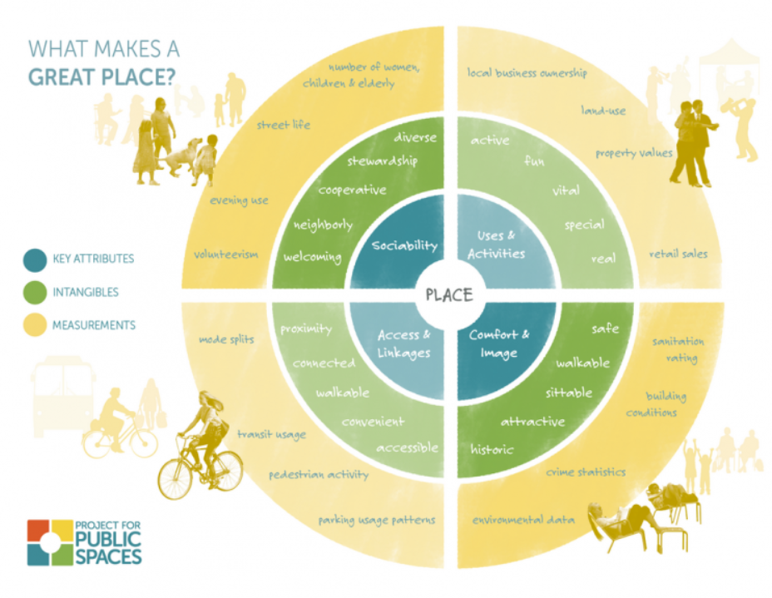
Current state of built environment – Public Space
6
Notes:
Jae:
Public spaces are where people meet and interact; socialize and discover common passions. In public spaces, communities and citizens affirm their shared rights to the city. A people-centred public space is central to the notion of a livable and human environment.
Public spaces not only provide a venue for individuals to interact and play but are the foundation for community building. Public spaces are mostly divided among 4 types:
Open (like parks and beaches)
Closed (like libraries and museums that have not only specific hours but locks preventing access)
Specialized (like sporting grounds, and recreational facilities that are designed with specific usage in mind)
and Hybrid (like a street or sidewalk, an open area that can but sequestered or closed temporarily for public safety, mobility, or community events).
Despite the differences all of them are of can be made into destinations.

Slide 7
Built Environment & Mental Health
There have been different studies conducted in the US, as well as China and Canada, that show walkable communities contribute to one’s overall well-being and desire to be physically active.
In 2020 when access to public spaces was decreased, one study found that individuals were losing the desire to go outdoors, which affected their overall mental state⁵.
This means that we need to not only design public spaces to support mental health but neighborhoods should also be built to support walkability.
Traditional⁶ Suburban Enclosed/Gated Cluster
7
Notes:
Jae:
Expanding on the intersection of built environment, space making, and mental health; a number of studies have documented what happens to mental health when accessibility to built environments is removed. This was most recently seen on a global scale during the 2020 Covid pandemic and most acutely felt by individuals who had mobility restrictions. The study in Journal of Transport & Health found that as lack of ability to access walkable environments and public spaces decreased, so did the desire for physical activity.
That lack of desire was also shown to have a negative outcome with regards to mental health. Ensuring that walkable communities and public spaces are both accessible and desirable can create environments that are critical to preventing depression and anxiety.
So, the focus should be on creating walkable communities that include public spaces, residential, and commercial space. The pictures at the bottom are a snapshot of 4 different types of neighborhoods. Traditional neighborhoods have infrastructure designed around the 1940’s-1950, when most Americans did not own cars. So for all the changes that have occurred in neighborhood and community design (suburban/Gated) the most walkable neighborhoods that best support mental health are those designed around the traditional model.
Ruoyu Wang, Yi Lu, Jinbao Zhang, Penghua Liu, Yao Yao, Ye Liu, The relationship between visual enclosure for neighborhood street walkability and elders’ mental health in China: Using street view images,
Journal of Transport & Health, Volume 13, 2019, Pages 90-102, ISSN 2214-1405, https://doi.org/10.1016/j.jth.2019.02.009.

Slide 8
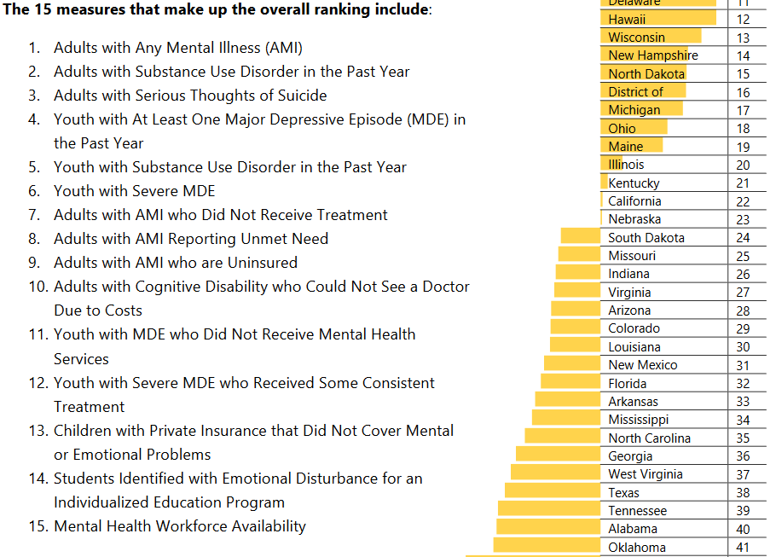
Access - Mental health deserts
Mental Health Desert Facts:
As of 2022, 570 counties across the United States still have no psychologists, psychiatrists or counselors.
9 Counties in Oklahoma have 0 mental healthcare providers.
Another 9 have less than 5 mental healthcare providers.
Seventy-five percent of rural counties across the country have no mental health providers or fewer than 50 per 100,000 people.
8
Notes:
Jae:
So lets shift to access, Covid not only shined a light on the disparities felt by those who lived in communities with low walkability but also those who lived in mental health deserts.
In 2020 the gap between those who had access to mental healthcare was revealed to be ever increasing in southern states and Oklahoma was no exception. At that time, Oklahoma ranked in the bottom 10 for overall access to mental health care.
This discrepancy in access created what we now know as mental health deserts. Areas in which access to mental health services falls below a standard threshold. During the Pandemic Oklahoma was ranked in the bottom ten (45th in 2021 and 41st in 2020 respectively) for overall health access, this is according to the State of mental health in American report. Though we have slightly increased our ranking in 2022 our access suffers the most in our rural counties with 9 counties still having 0 providers and another 9 counties having less than 5 providers.

Slide 9
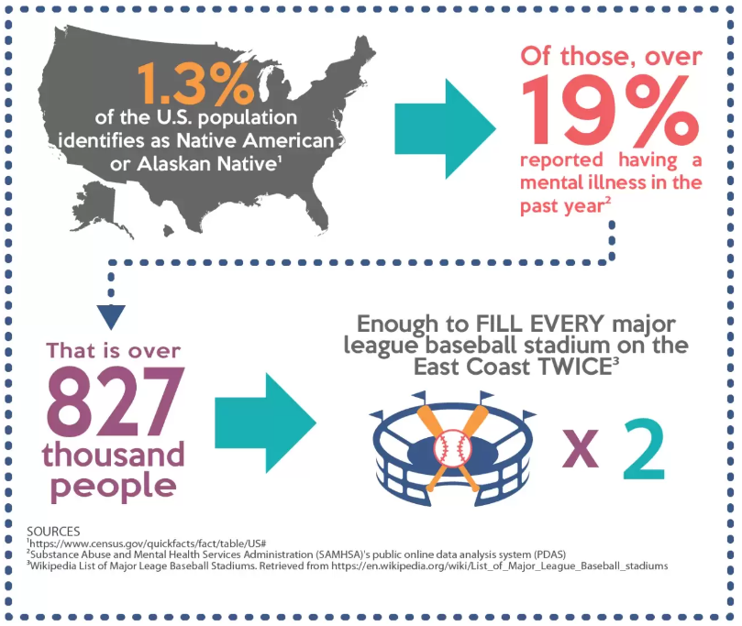
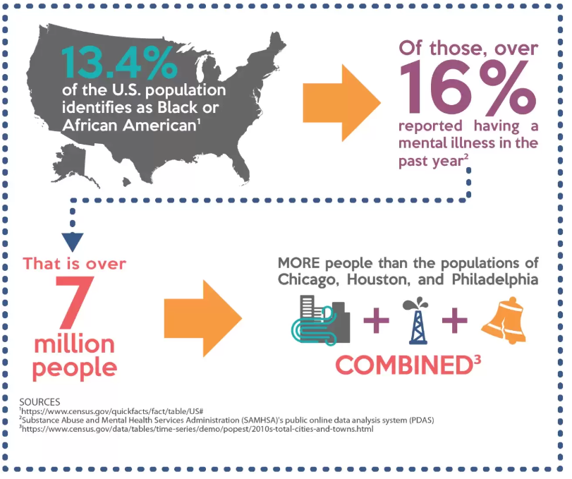
Mental health desert – BIPOC Access
Native American & Alaskan Native Population⁴
African American Population Access²
9
Notes:
Jae:
Access to mental health services is not only limited by rurality but also by population. Many Native/Indigenous communities are also feeling the affects of mental health deserts. Access is limited because most clinics and hospitals of the Indian Health Service are located on or near reservations which are traditionally rural. And as we saw in the previous slide, that only serves to compounds the issue as a majority of Native/Indigenous people in America live outside of tribal areas. While access for native groups is largely due to rurality, rurality alone is not the deciding factor for access inequity
In 2018, 58.2 percent of Black and African American young adults and 50.1 percent of African American adults with serious mental illness did NOT receive treatment, and with only 8% of black and African American individuals living in rural areas according to the 2018 Rural America at a Glance Report²; its clear that the inequity stretches from city streets, to farmland, to reservations.

Slide 10
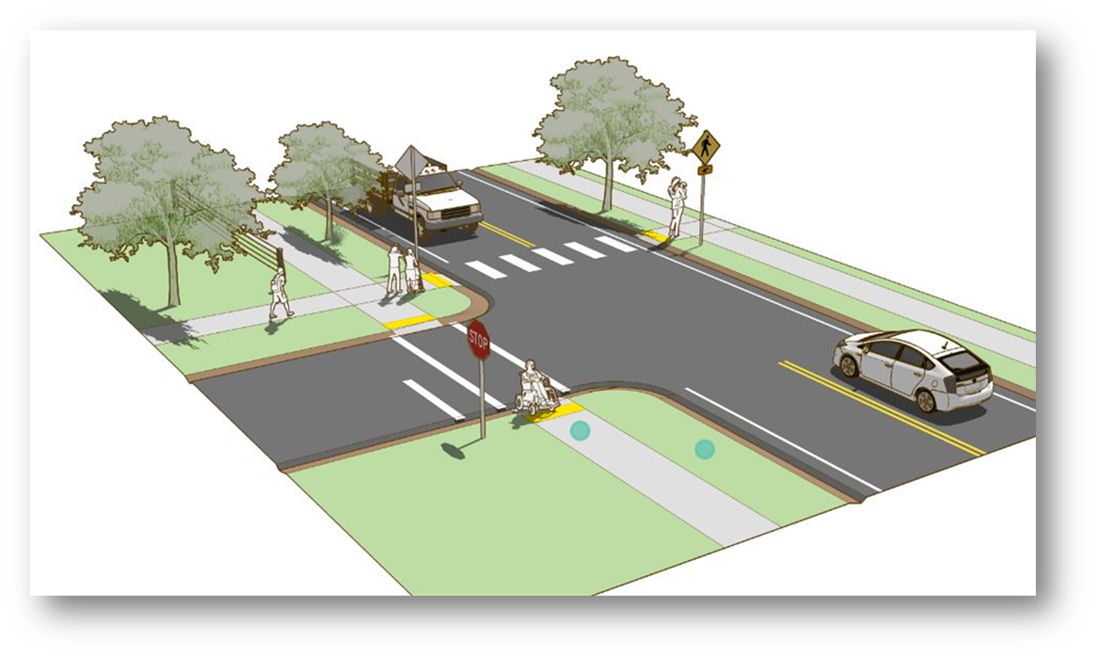
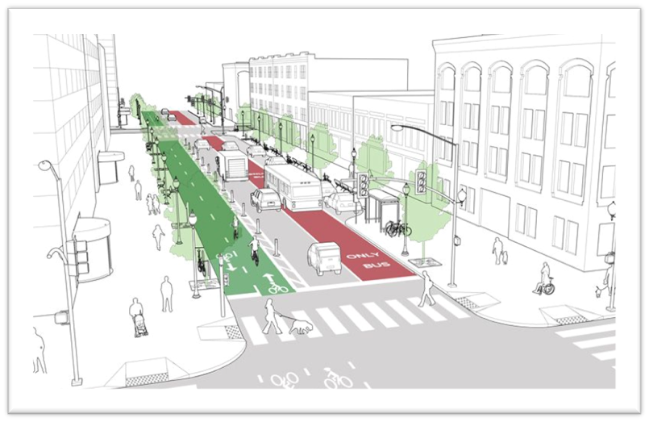
Different types of built environment
Visually Separated¹
Physically Separated¹
Complete Streets¹
10
Notes:
Magen:
There is no one size fits all approach to creating better built infrastructure that is supportive of physical activity. Communities have different needs and budgets for improvements. Any improvements are better than none, though some options provide more benefits including feelings of safety when engaging in physical activity. Let’s take a look at some of the different types of built environment changes that can be made.
Visually Separated:
Bike Lane
Paved Shoulder
Physically Separated:
Sidewalks
Sidepaths
Shared Use Paths
Complete Streets:
Complete Streets are streets designed and operated to enable safe use and support mobility for all users. Those include people of all ages and abilities, regardless of whether they are travelling as drivers, pedestrians, bicyclists, or public transportation riders.
These different built environment strategies have three things in common: A safe space that is accessible to all, reduces “walking along roadway” crashes, and increases the amount of walking throughout communities, while also maintaining town character (1).
These different types of built environments have been proven to increase physical activity among people of all ages and abilities. They not only promote biking, walking, running, etc, but they also help provide pathways to other activities. Many incorporate these with connections to parks, playgrounds, and trails- they also have trail heads that incorporate downtowns. It is an attraction point for families to know they can go outside and have a safe, reliable space for physical activity, provides a social aspect for people who use this opportunity to be physically active but also connects to friends or neighbors, and finally, provides options for different types of physical activity.
(ALTA, Planning + Design. (n.d.). Facilities for Walking and Biking. Small Town and Rural Design Guide. Retrieved July 25, 2022, from https://ruraldesignguide.com/)

Slide 11
implementation
How do we create walkable communities effectively and efficiently?
Considerations for implementation:
Size/Scale
Support (local partners)
Location
11
Notes:
Magen:
As we saw with the previous slide, there are many different options when creating a walkable community. What are some considerations we could utilize towards reaching that “walkability” goal that has not only been proven to be effective, but also efficient?
Here are some things we need to consider:
Size/Scale
Support (local partners)
Location

Slide 12
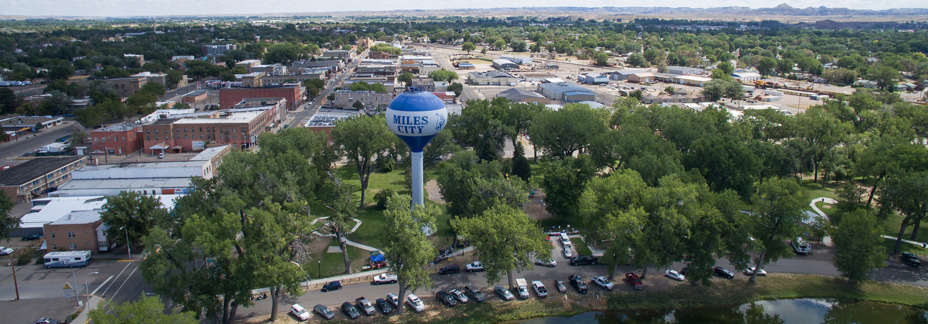
Implementation- example
Miles City, Montana³
12
Notes:
Magen:
Miles City, Montana -
Miles City has an Active Living Taskforce- started Safe Routes to School Program
Support: the Montana Department of Transportation and the bicycle and pedestrian safety program at Garfield Elementary School
Most students walk or ride their bikes to school
Low-income residential area
Sidewalks installed connect various neighborhood streets and goes directly to the school
Access from neighborhoods to local park
Bike and Pedestrian Program at school- provided by health enhancement staff and the school resource officer.
FUNDING
The project was funded with Federal (safe routes to schools) SRTS funds, as well as Community Transportation Enhancement Program (CTEP) funds and local matching funds from Miles City. While constructed at the same time, funding for the project was applied for in phases and received funding in two different SRTS funding cycles.
(Committee on Environmental Health. (2009). The built environment: designing communities to promote physical activity in children. Pediatrics, 123(6), 1591-1598.)

Slide 13
implementation
Size: Large Scale usually includes new facilities or streets, incorporates multiple entities in a jurisdiction or community, and can take up to years. Smaller scale projects can include single elements like lighting or wayfinding.
Support: Local stakeholders as well as political support can make or break implementation of built environment changes. Community leaders, city planners, and businesses should be a part of the decision-making process, as well as ensuring that the public is in favor of the changes and that the changes are culturally relevant.
Site: Location, Location, Location. As we talked about earlier identifying the right site for change can impact everything from stakeholder support to public perception and usage.
13
Notes:
Magen:
What methods could we utilize when trying to implement these walkable communities? Size matters. And, depending on funding the only available option is something that is less invasive and something that can be put into place fairly quickly. Providing smaller options to local communities, like a small wayfinding sign, could help increase local support through stakeholders or city governments. Location also plays a very critical role when implementing a walkable community. Being able to identify the right place for updates will help gain overall support from everyone involved in the project and provide interest within your community.

Slide 14
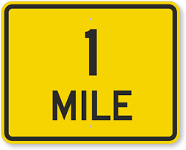
Implementation - Cost
One thing that remains as a consistent inhibitor of progress throughout the process is cost. Creating walkable environments can be a huge fiscal undertaking.
…Of Bike Lanes
…Of Trail
…Of Sidewalk
…Of Complete Streets
14
Notes:
Jae:
Cost is the main inhibitor of built environment change. To give a glance into the scope of this we’re going to look at some cost. I’ll take the first three numbers I hear, price is right rules, closest without going over for:
1 Mile of Bike Lanes (Assuming: bike lanes on both sides, street is already wide enough, no resurfacing needed): Total: $598,571
1 Mile of Sidewalk (single side of the street): Total: $686,400
1 Mile of Trail (assuming no need for bridges and no amenities): Total: $1,700,000
1 Mile of Complete Streets (Assuming: narrowing from 4 lanes down to 2 lanes, bike lanes as striping only, adding sidewalks to both sides, adding trees and or street furniture every 100’ on each side, not doing any traffic signal or sign upgrades, and not adding pedestrian bump-outs): Total: $2,751,657
So as we see, cost can be an inhibiting factor but Magen is going to share some quick wins that can help overcome this.

Slide 15
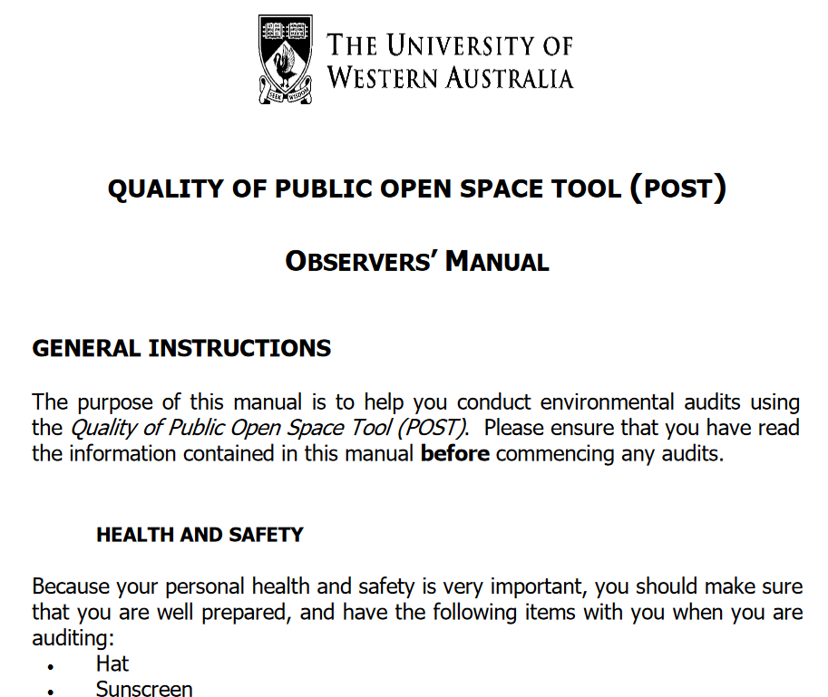
Implementation – Quick Wins
These types of implementation strategies are either a) a small fiscal commitment or b) small time commitment or c) both.
Education &
Assessment
Community Level Intervention
15
Notes:
Magen:
Quick Wins are either implemented quickly (time bound) or in a highly cost effective manner.
Beginning with education and assessment, if knowledge is power, knowing the walkability or desirability of your parks, greenspaces, and points of interest within the community is key. Environmental assessments like the Community Park Audit Tool (CPAT), Physical Activity Resource Assessment (PARA), and the Quality of Public Open Space Tool (POST) allow stakeholders to quickly assess areas for possible changes.
Keeping your scale small to build momentum is an excellent way improve walkability. Policy, advocacy, and marketing work hand in hand to increase walkable communities. The watch for me OKC program focused on creating increased awareness for pedestrians and bikers.

Slide 16
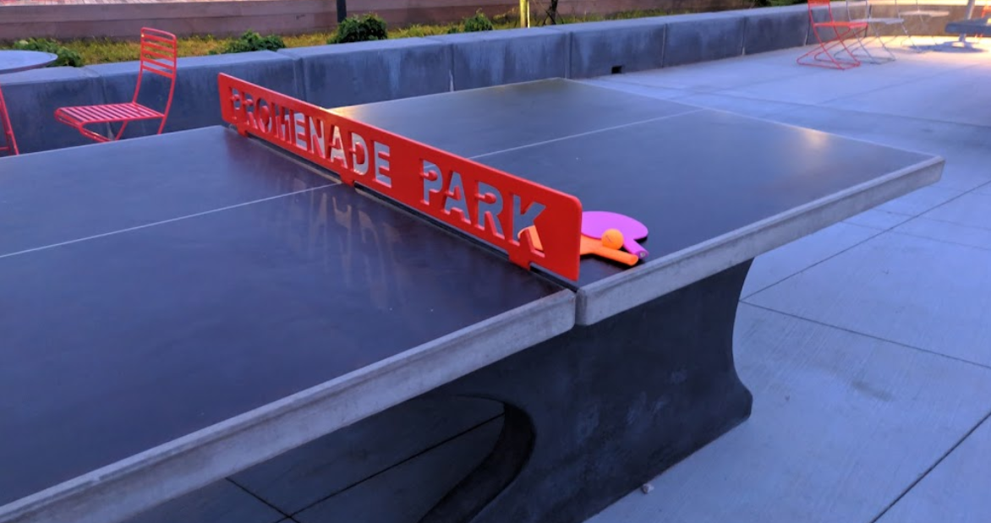
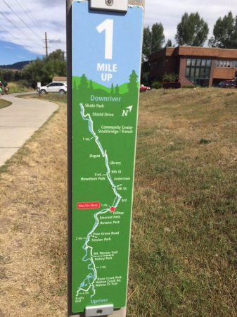
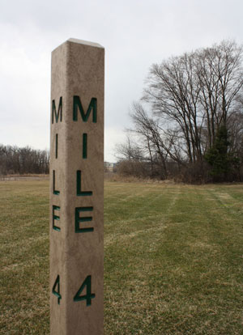
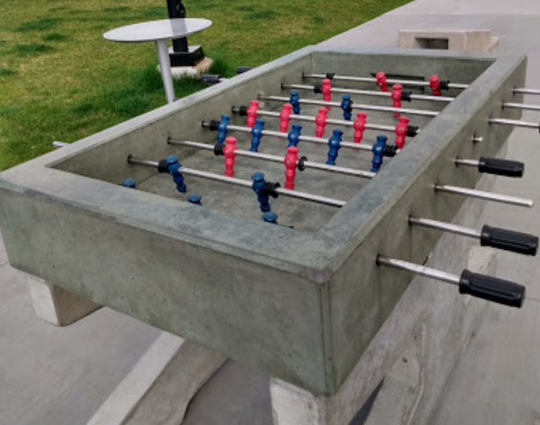
Implementation – Quick Wins
Quick Wins: These types of implementation strategies are either a) a small fiscal commitment or b) small time commitment or c) both.
Convenience & Amenities
Signage & Beautification
16
Notes:
Magen:
Convenience & Amenities – Using local companies, organizations and stakeholders to support walkability and create places, not just spaces.
Beautification – Work with what nature is giving you. If you have water elements, incorporate them into your projects for a quick win. Trail improvement CAN be a well mapped out sign that gives details about the entire trail but it can also be simple mile markers. Lastly beautification may entail a large investment in adding or sprucing up a green space but don’t overlook local artists who can bring their visions to life in your communities. Incorporating artwork can turn drab walls into and corridors into walkable destinations.

Slide 17
Questions?
Notes:
Magen & Jae

Slide 18
References
ALTA, Planning + Design. (n.d.). Facilities for Walking and Biking. Small Town and Rural Design Guide. Retrieved July 25, 2022, from https://ruraldesignguide.com/
Black and African American Communities and Mental Health. Mental Health America, Retrieved from Black and African American Communities and Mental Health | Mental Health America (mhanational.org)
Committee on Environmental Health. (2009). The built environment: designing communities to promote physical activity in children. Pediatrics, 123(6), 1591-1598.
Native and Indigenous Communities and Mental Health. Mental Health America, Retrieved from Native and Indigenous Communities and Mental Health | Mental Health America (mhanational.org)
Rural America at a Glance, 2018 Edition. John Cromartie. Retrieved October 4, 2022, from USDA ERS - Rural America at a Glance, 2018 Edition
The relationship between visual enclosure for neighbourhood street walkability and elders’ mental health in China: Using street view images, Journal of Transport & Health, Volume 13, 2019, Pages 90-102, ISSN 2214-1405, from https://doi.org/10.1016/j.jth.2019.02.009
Neighborhood Design, Physical Activity, and Wellbeing: Applying the Walkability Model, Adriana A. Zuniga-Teran, Barron J. Orr, Randy H. Gimblett, Nader V. Chalfoun, David P. Guertin, and Stuart E. Marsh. International Journal of Environmental Research and Public Health, January 13, 2017.

